Slide 1

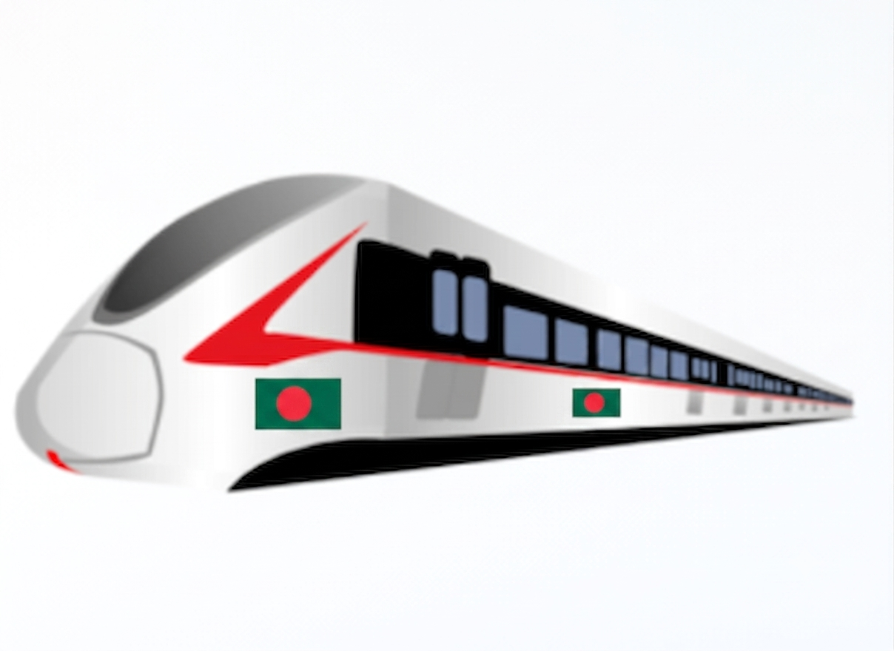



Spider-Man's Spider-Sense for Bangladesh Railways
Can Smart Sensors & Control Systems Prevent Railway Accidents?
DIU CSE 325 Presentation Group 08

Slide 2



Group & Course Information
Student Name | Student ID
Tanvir Kabir | 232-15-753
Mynuddin Ahmed | 232-15-179
Hasan Tarek | 232-15-650
Muntasir Chowdhury | 232-15-462
Shafin Ahmed | 232-15-184
Mehedi Hasan
Lecturer
Department of Computer Science & Engineering Daffodil International University
DIU CSE 325 Presentation Slide 2

Slide 3

Introduction: Bangladesh Railways
Vital lifeline for affordable national transit
Transports millions of citizens daily across districts
Critical need for modern safety infrastructure
Rising derailments call for automated prevention
Instrumentation and Control Slide 3

Slide 4





Core Railway Safety Challenges
Track Defects
Human Error
Micro-cracks, thermal track expansion, and rail displacement going undetected.
Manual inspection delays, driver fatigue, and delayed reaction time during hazards.
Poor Monitoring
Unmanned Crossings
Absence of continuous real-time telemetry across thousands of track kilometers.
Frequent collisions at unauthorized and un-signaled level railway intersections.
Problem Identification Slide 4

Slide 5



Fictional Inspiration vs Engineering Reality
The Concept: "Spider-Sense"
Engineering Translation
Autonomous Early Hazard Premonition
Smart Instrumentation Network
•
Zero-latency hazard awareness
•
Multi-sensor telemetry along tracks & trains
•
Continuous omnidirectional environmental scanning
•
Sub-second anomaly detection & edge computing
•
Instinctive preventive reflex triggering
•
Automated signal feedback & braking actuation
Conceptual Metaphor Slide 5

Slide 6





Core Engineering Pillars
Instrumentation
Smart Sensors
Measuring physical track parameters (stress, temperature, vibration) precisely.
Transducers equipped with built-in signal conditioning and digital output capabilities.
Real-Time Telemetry
Control System
Instant data transmission to control units using low-latency wireless networks.
Feedback loops that process sensor inputs to trigger emergency automatic brakes.
CSE325 Technical Framework Slide 6

Slide 7






Proposed System Architecture:
Railway Track
Sensors
Microcontroller
Network
Control Room
Auto Brake
Sensor Integration
Data Sensing
Signal Processing
GSM/IoT Comms
Central Monitor
Safety Actuation
7

Slide 8





Smart Sensor Suite Selection:
Vibration
Ultrasonic
Thermal
Piezoelectric sensors detect track structural deformities.
Measures obstacle distance & track clearance.
Monitors rail heat expansion to avert buckling.
Camera
GPS Module
Crack Detector
AI computer vision detects track debris & hazards.
Provides real-time location telemetry & velocity.
IR & continuity sensors locate micro rail fractures.
8

Slide 9






Step-by-Step Working Workflow
The system follows a continuous monitoring-to-prevention cycle, ensuring that hazards are detected and addressed in real time. This automated process minimizes human response time and improves overall railway safety.
Monitoring
Data Collect
Analysis
Hazard Detect
Warning
Prevention
24/7 track scanning
Sensor sampling
Edge MCU evaluation
Threshold trigger
Driver alert signal
Brake actuation
Operational Pipeline Slide 9

Slide 10



System Advantages & Implementation Challenges
Key Advantages
Implementation Challenges
24/7 autonomous monitoring with zero fatigue
High initial hardware deployment investment
Sub-second alert latency prevents collision
Extreme weather exposure on outdoor sensors
Predictive maintenance lowers repair costs
Remote track network connectivity gaps
Feasibility Analysis Slide 10

Slide 11








Broader Infrastructure Applications
Transportations
Bridges
Agriculture
Industrial
Tunnels
Health
Applications Slide 11
Presented By Shafin Ahmed (232-15-184)

Slide 12





Future Horizons & Emerging Scope
AI & ML
IoT
Drones
Digital Twins
Auto Control
Sat-Comms
Presented By Shafin Ahmed (232-15-184)
Future Work Slide 12

Slide 13

Summary & Final Takeaway
Core Inspiration: "Spider-Sense"
Integrated System
Key Benefits
Future Vision
Key Takeaway
Fictional premonition Life-saving reality
Presented By Shafin Ahmed (232-15-184)
Conclusion Slide 13

Slide 14

Questions & Answers
Thank You for Your Attention!
Department of Computer Science and Engineering • Daffodil International University
Instrumentation and Control Presentation Slide 14

Slide 15
Image Sources
https://share.gemini.google/PF5zOK4SySPp
Source: gemini.google.com

